Slide 1



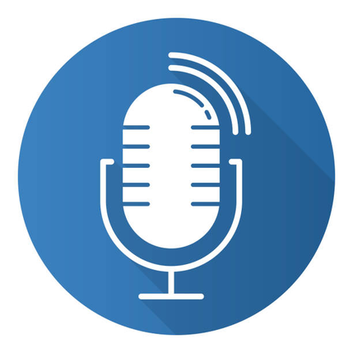
PRASAD V. POTLURI SIDDHARTHA INSTITUTE OF TECHNOLOGY
TEXT TO SPEECH AND SPEECH TO TEXT CONVERTER
T.N.S.Samanvitha (22501A05H6)
P.Amulya (22501A05D7)
P.PhaniKrishna (22501A05D8)

Slide 2
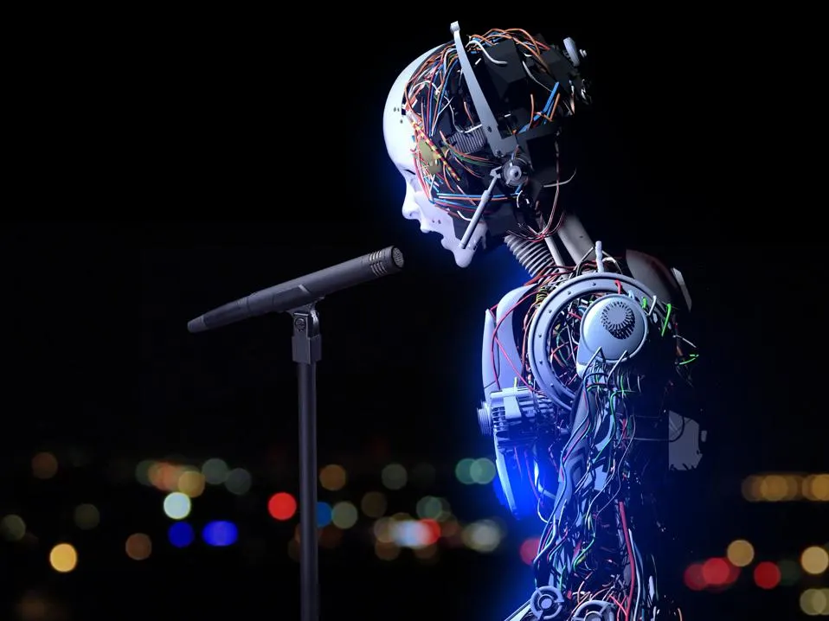

ABSTRACT
This project develops a bidirectional converter that transforms text into natural-sounding speech and speech into accurate text, enabling seamless human–computer communication. It integrates gTTS for text-to-speech and Wav2Vec2 for speech-to-text, ensuring real-time interaction. System performance is evaluated using Word Error Rate (WER) via the JiWER library, and all features are combined into an interactive Gradio interface.

Slide 3
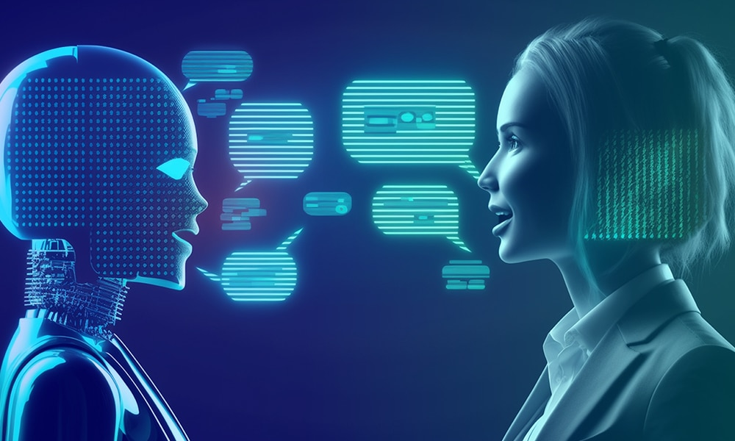

PROBLEM STATEMENT
Communication between humans and computers is often unimodal, limiting accessibility.
Existing systems may not provide real-time, accurate, and interactive conversions.
There is a need for a unified, efficient model that handles both TTS and STT with measurable accuracy.

Slide 4
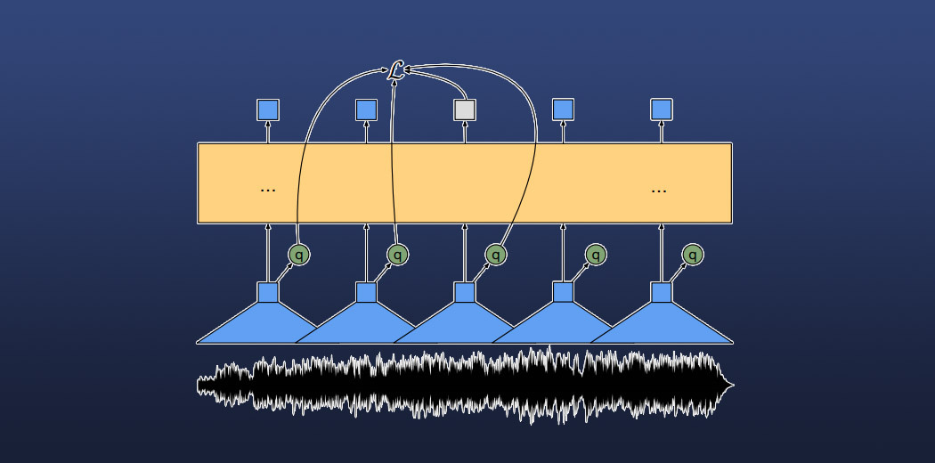

OBJECTIVES
Build a two-way converter between text and speech.
Ensure high transcription accuracy using Wav2Vec2.
Provide natural voice synthesis using gTTS.
Evaluate performance using Word Error Rate (WER).
Develop an interactive user interface using Gradio.

Slide 5
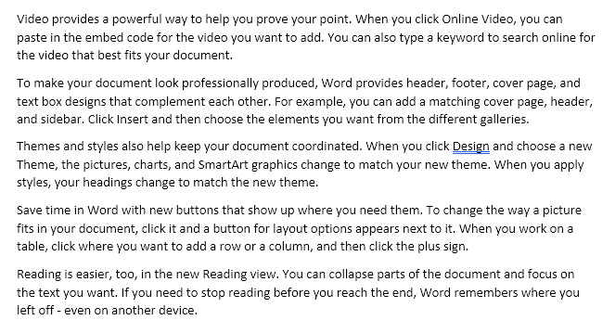
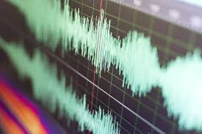
DATA SET
For Text-to-Speech (TTS): User-input text (English).
01
For Speech-to-Text (STT): Recorded or uploaded WAV/MP3 files sampled at 16 kHz.
02
Model Reference:
Wav2Vec2 (Facebook pretrained model) for STT
gTTS API for TTS
03

Slide 6
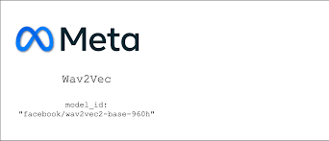



ALGORITHMS / TOOLS USED
Task | Library / Model | Description
Text to Speech | gTTS | Converts English text to natural voice
Speech to Text | Wav2Vec2 | Deep learning model for transcription
Accuracy Evaluation | JiWER | Calculates Word Error Rate
Interface | Gradio | Builds interactive web UI
Audio Processing | Librosa, SoundFile | Handle and sample audio files

Slide 7
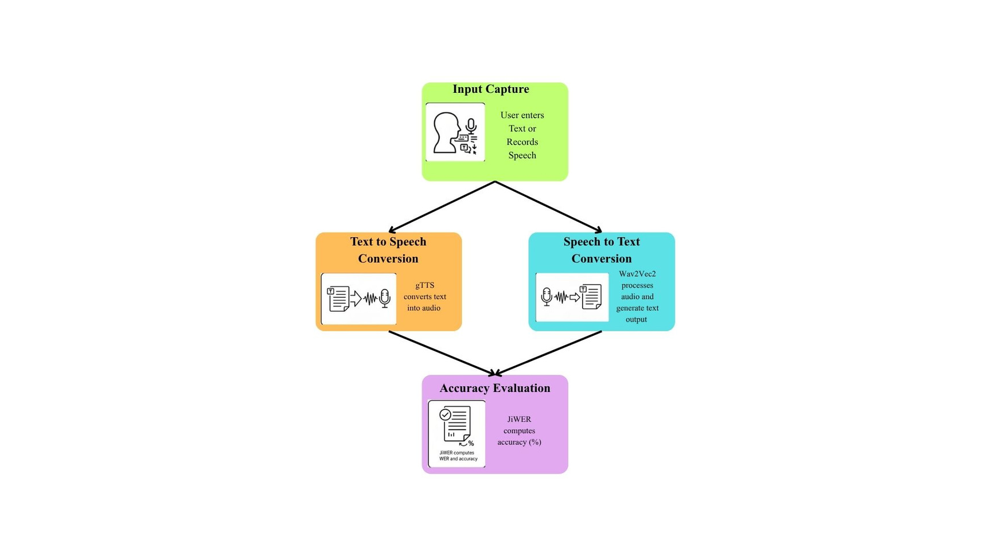
METHODOLOGY
Input Capture: User enters text or records/upload speech.
Text → Speech Conversion: gTTS generates MP3 output.
Speech → Text Conversion: Wav2Vec2 processes and outputs text.
Accuracy Evaluation: JiWER computes WER and accuracy %.
Interface: Gradio organizes these into three tabs for user interaction.

Slide 8
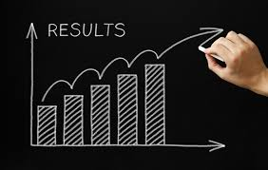
RESULTS
Successful bidirectional conversion between text and speech.
High transcription accuracy for clear English speech.
WER < 10% in most test cases.
User-friendly interface with real-time feedback.
Verified model performance via JiWER accuracy evaluation.

Slide 9
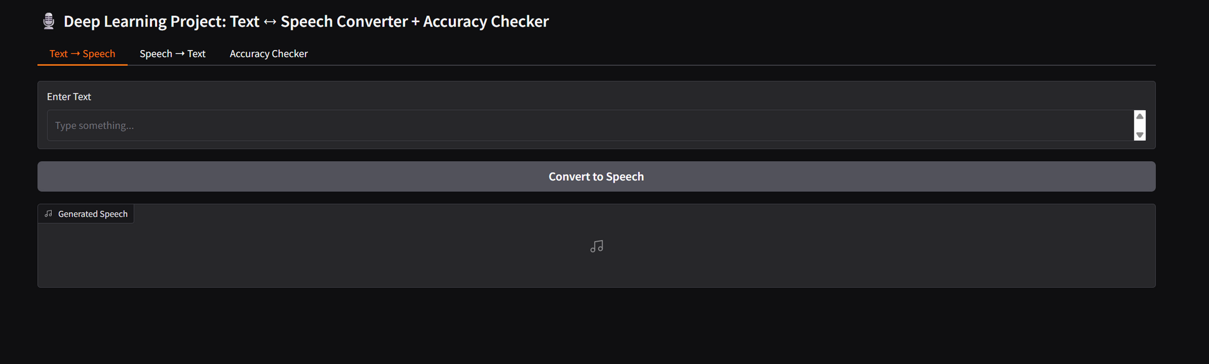
OUTPUT SCREENSHOTS
View of the Gradio Interface

Slide 10
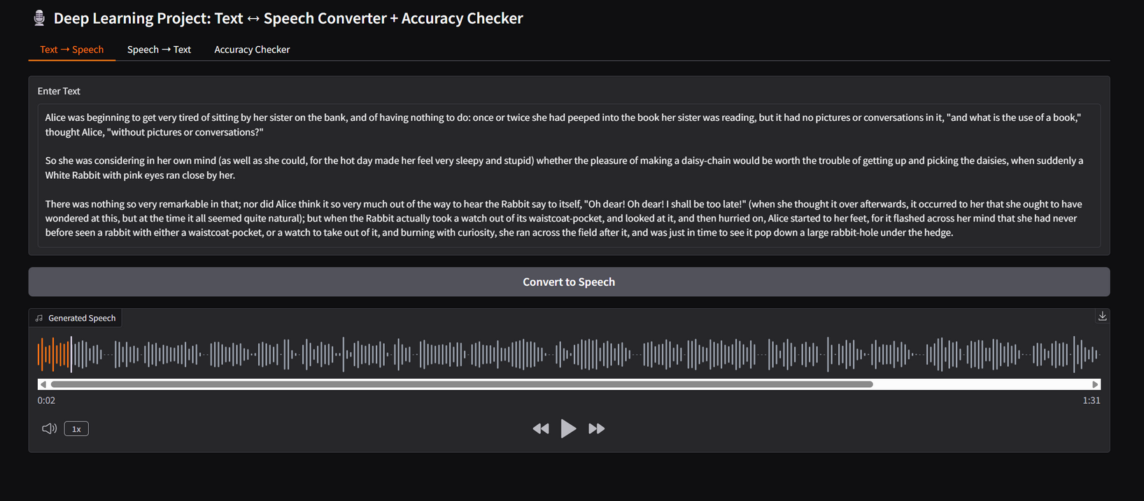
OUTPUT SCREENSHOTS
Text to Speech Interface

Slide 11
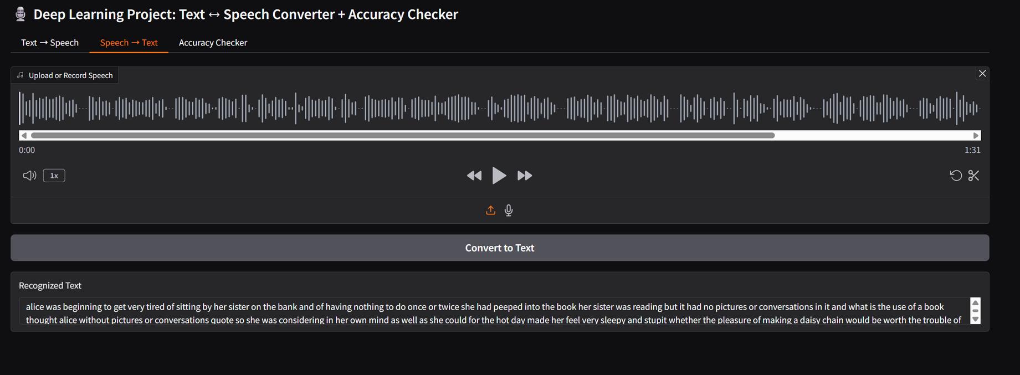
OUTPUT SCREENSHOTS
Speech to Text Interface

Slide 12
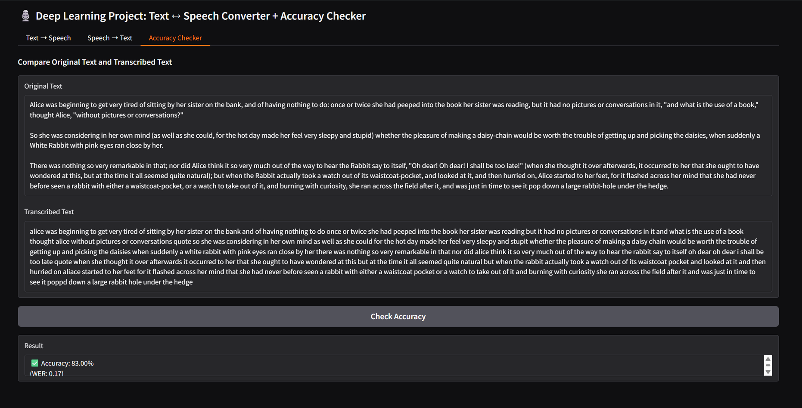
OUTPUT SCREENSHOTS
Accuracy Checker Interface

Slide 13

FUTURE PLANS
Add multi-language and accent support.
Integrate with chatbots, assistive tools, and voice assistants.
Improve noise robustness for real-world audio.
Deploy as cloud-hosted web/mobile app.

Slide 14

CONCLUSION
The developed system successfully performs bidirectional conversion between text and speech, ensuring smooth human–computer interaction.
By integrating gTTS for Text-to-Speech and Wav2Vec2 for Speech-to-Text, the project achieves high accuracy and natural voice output.
The use of JiWER for accuracy measurement provides a reliable performance evaluation based on Word Error Rate (WER).
The Gradio interface makes the application interactive, user-friendly, and suitable for real-time demonstrations.
Overall, the project demonstrates the effective use of deep learning and NLP techniques to enhance communication accessibility and automation.

Slide 15
THANK YOU

